Slide 1
My Creations
Gilles Butikofer - 2025

Slide 2
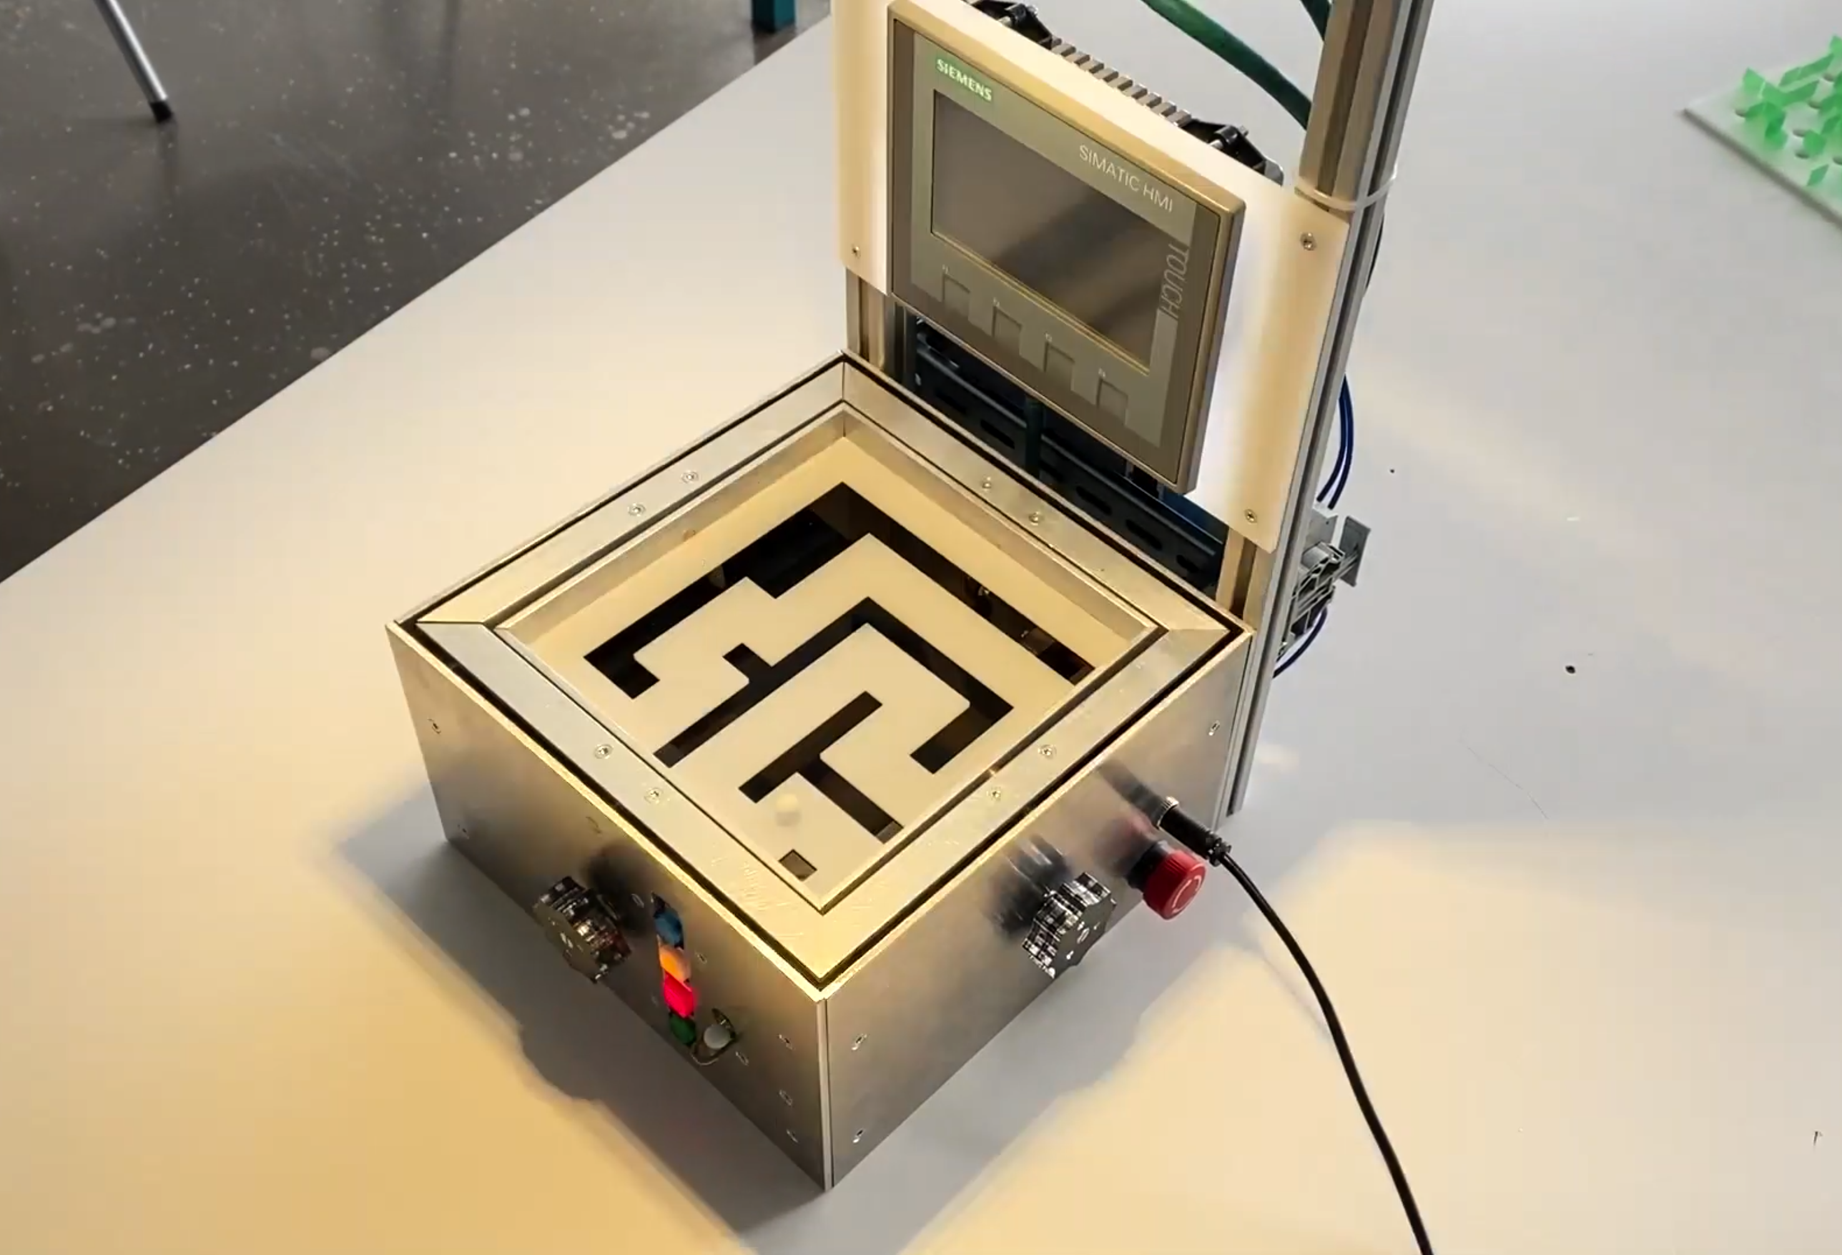

Automated Ball Maze
2021
Best automation project award
Skills developed :
Desing with Autodesk Inventor (CAD)
Electrical Diagram
Turning / Milling / Laser Cutting
Machining / Assembling / Wiring
Using an Cognex Industrial Camera
Using a Siemens SIMATIC S7-1200 Controller
Programming with TIA Portal

Slide 3
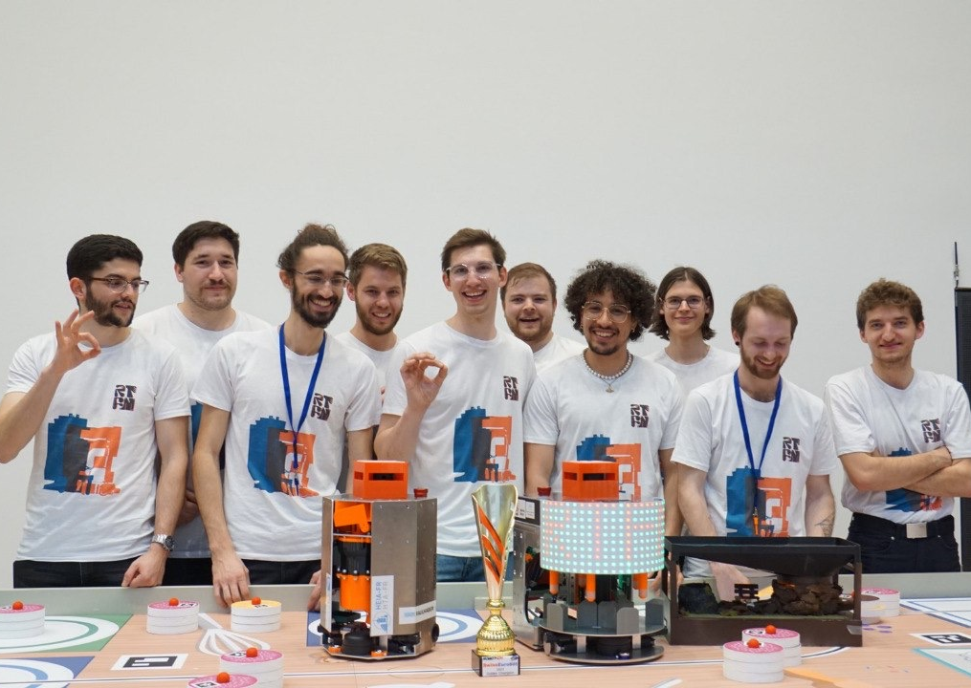
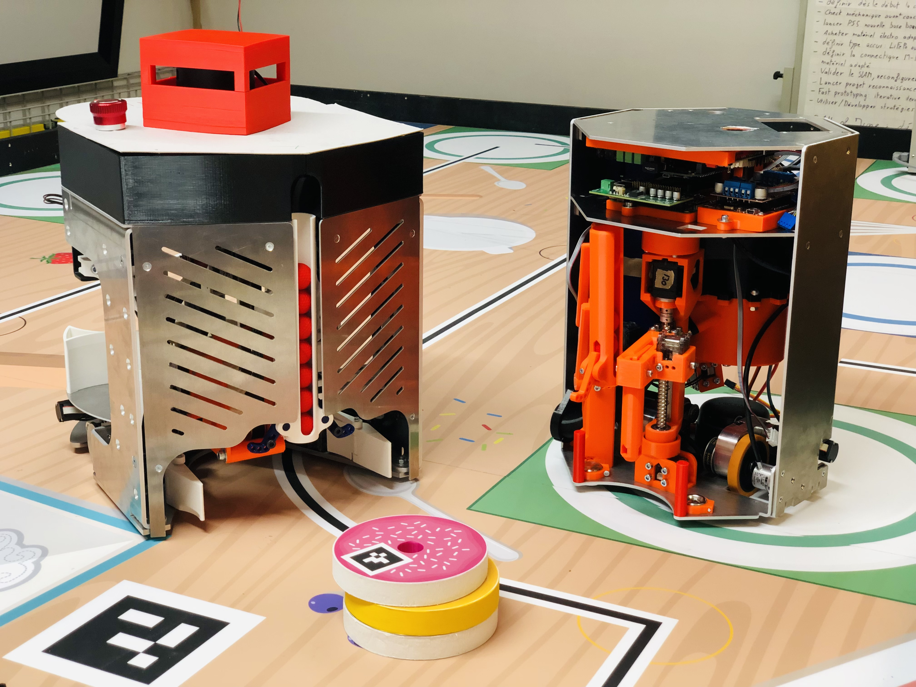


Eurobot 2023
2022-2023
Skills developed :
Interdisciplinary Teamwork
Deadlines Management
CAD Design with Siemens NX
Developing Reliable Mechanisms
Desing for 3D Printing & Laser Cutting
Assembling
Programming in Python

Slide 4
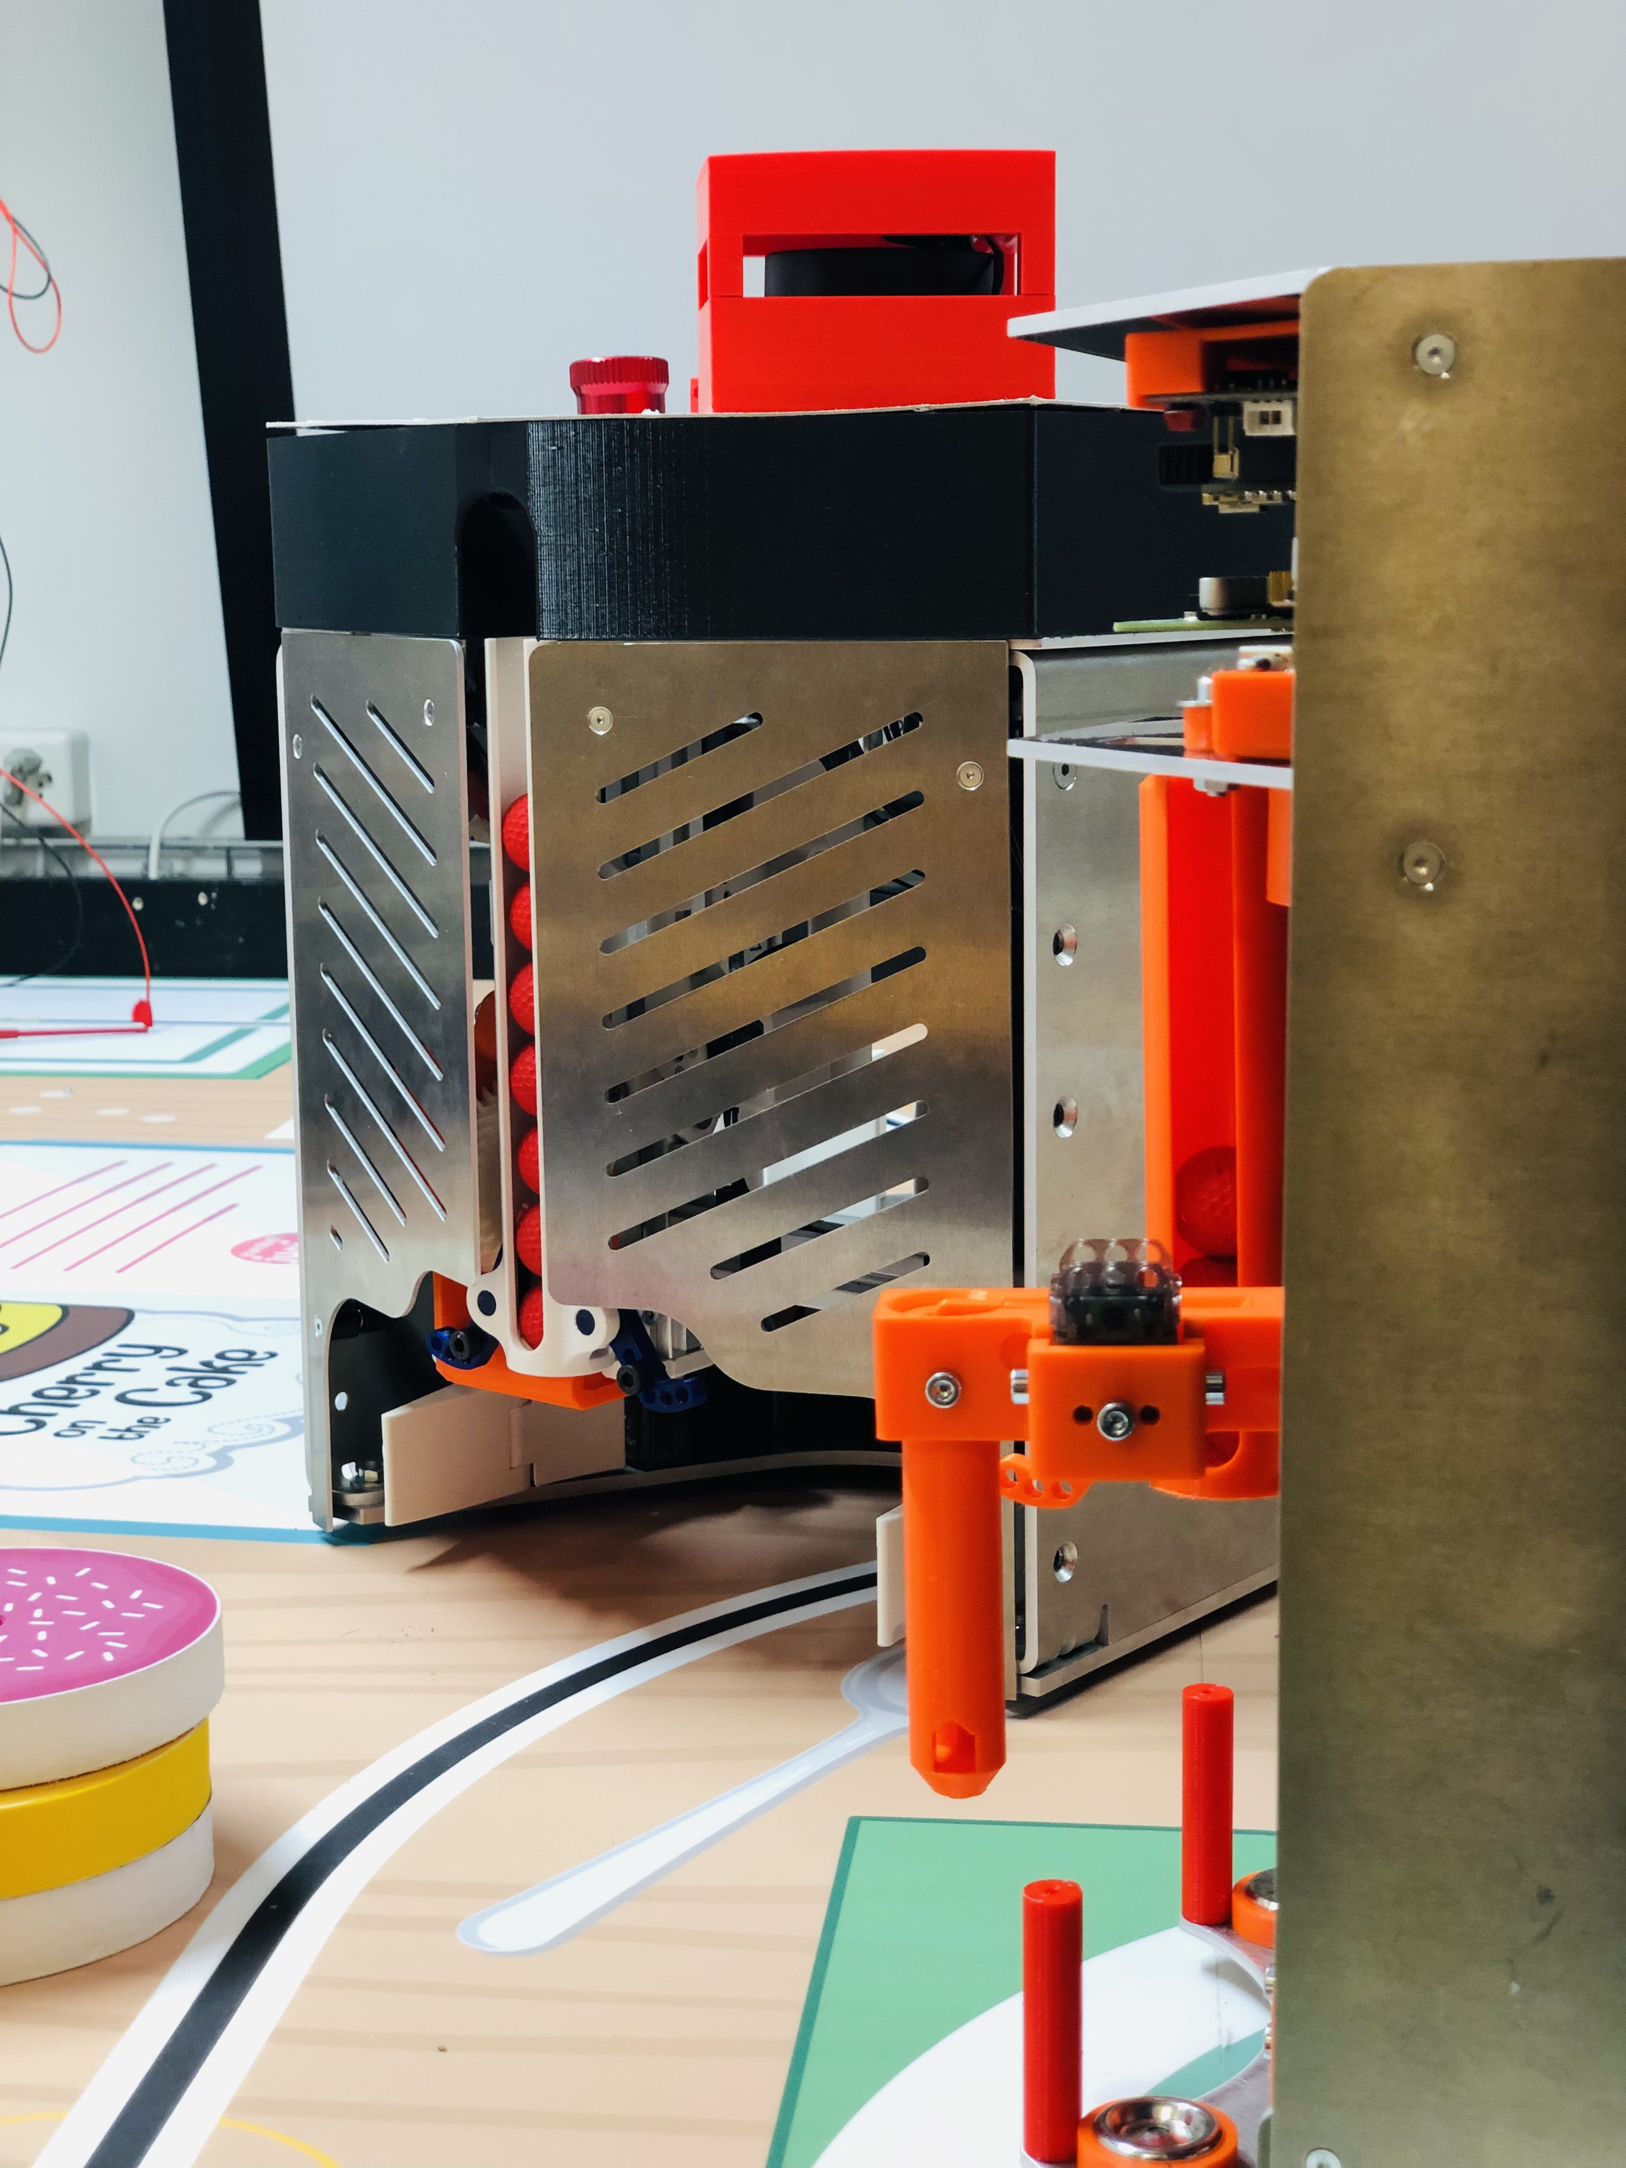
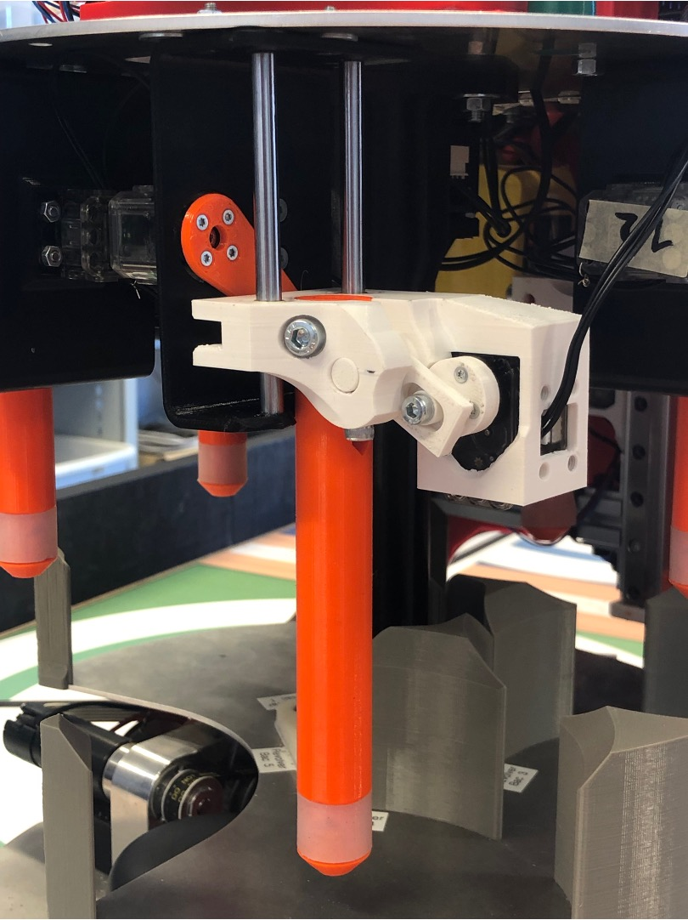
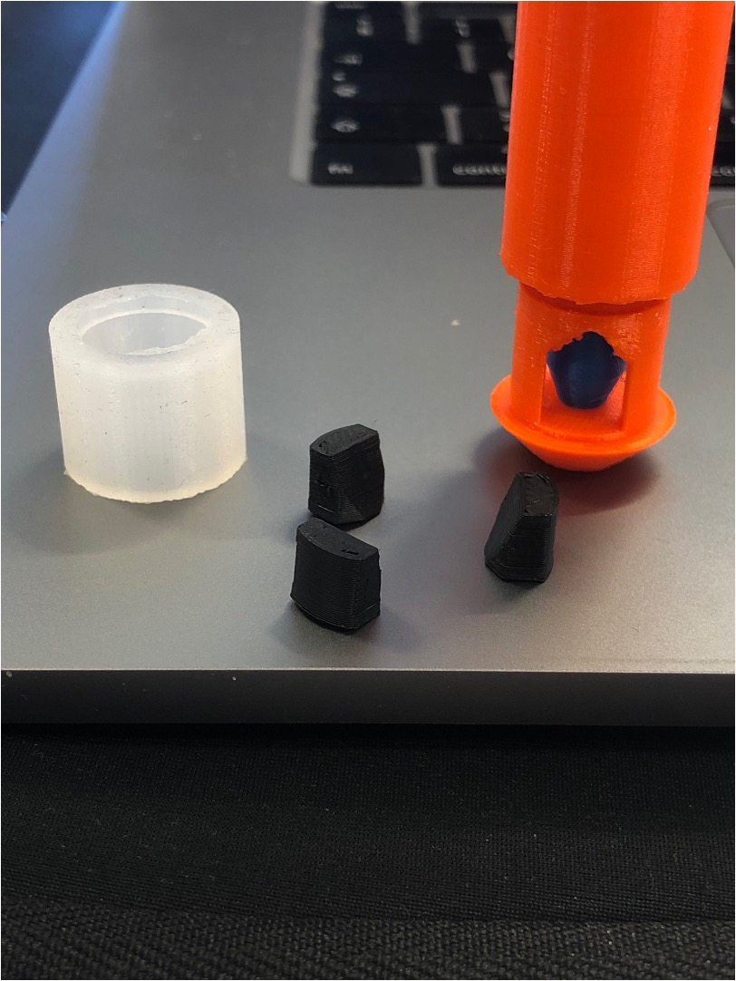
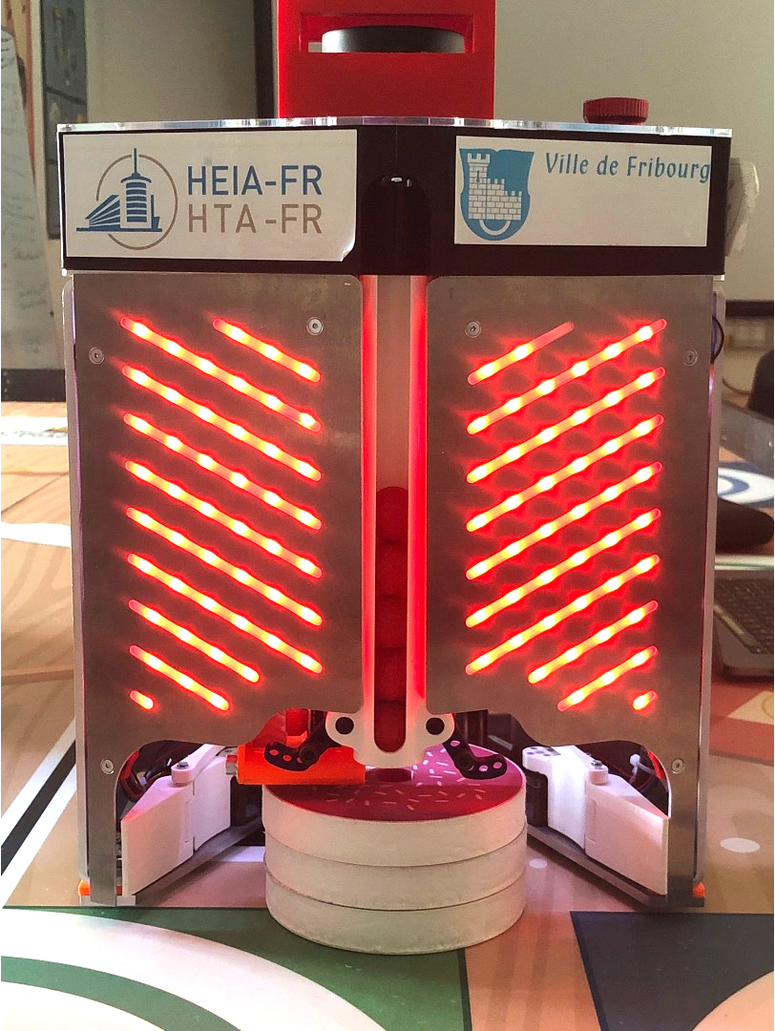
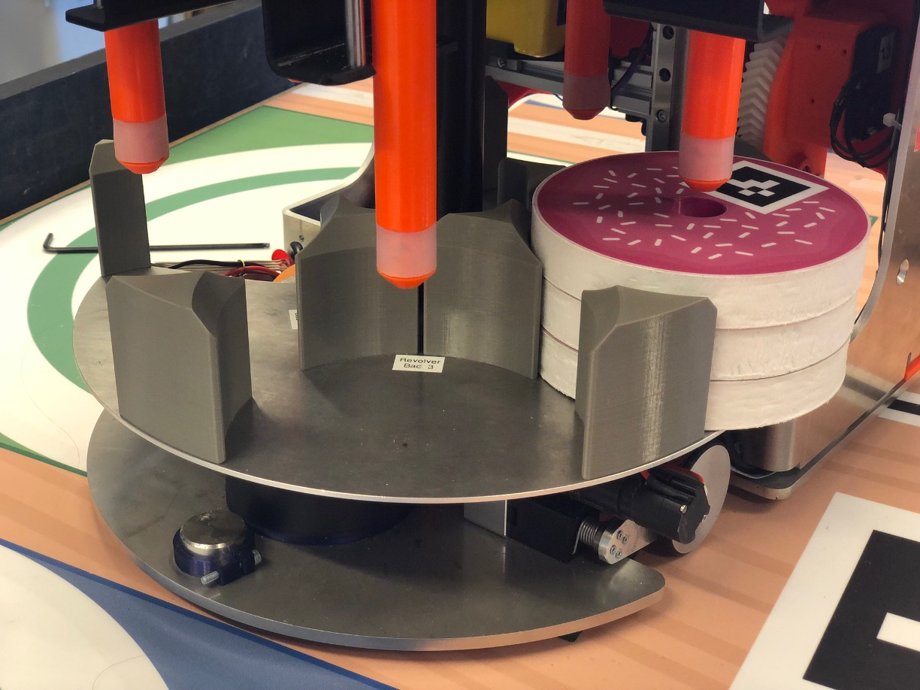
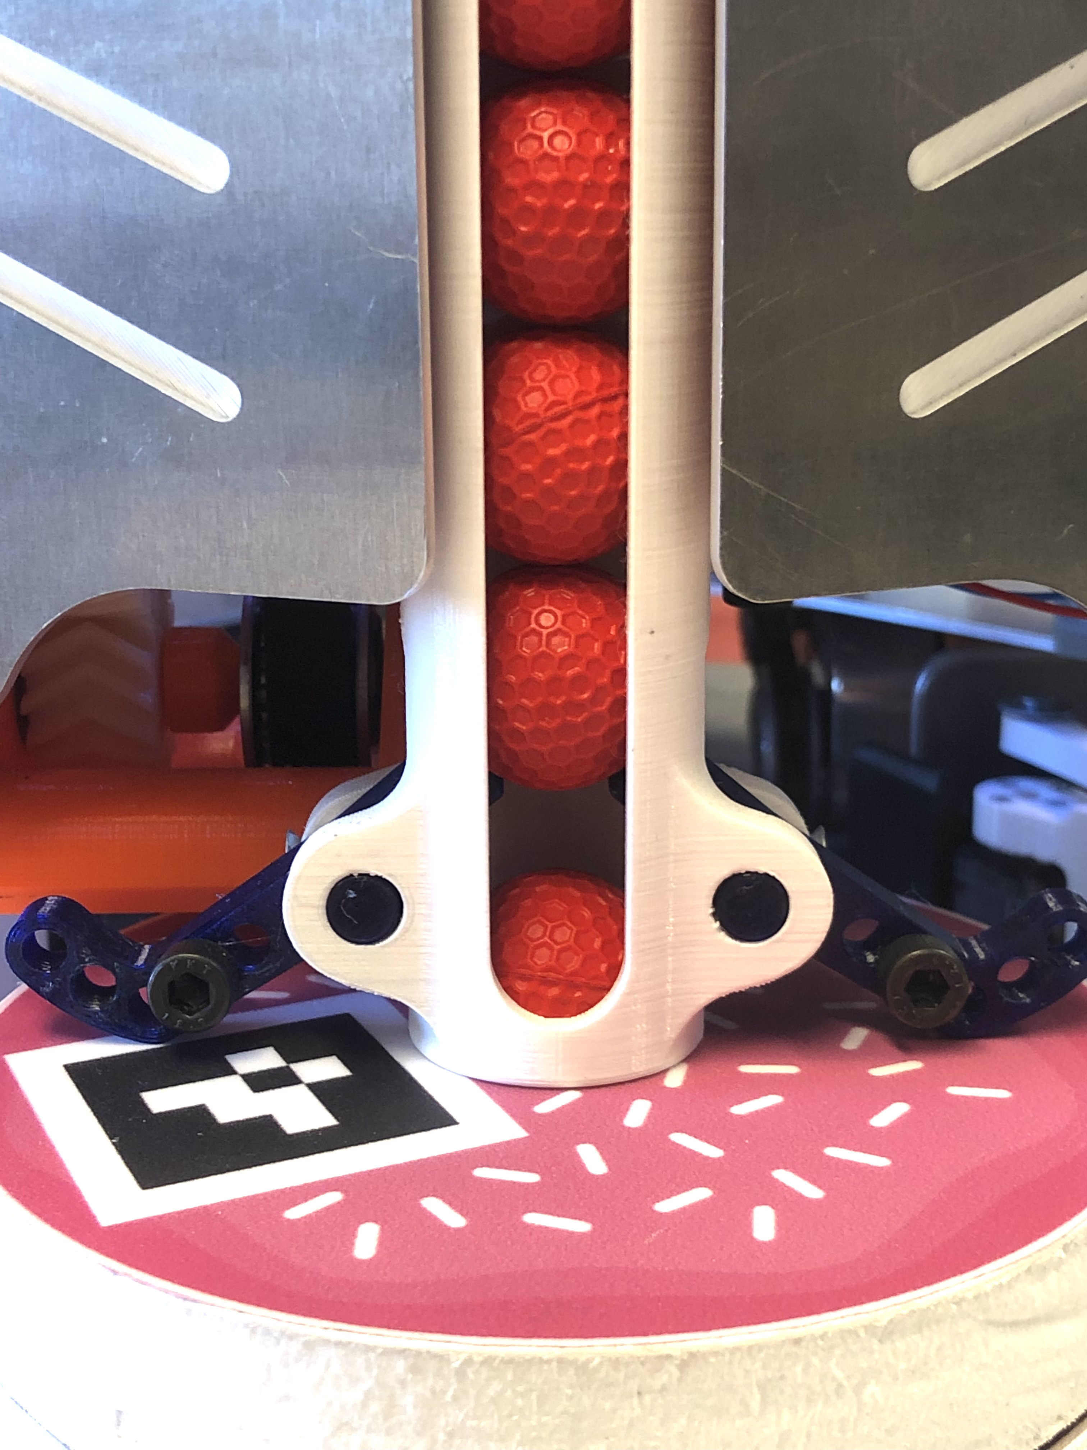
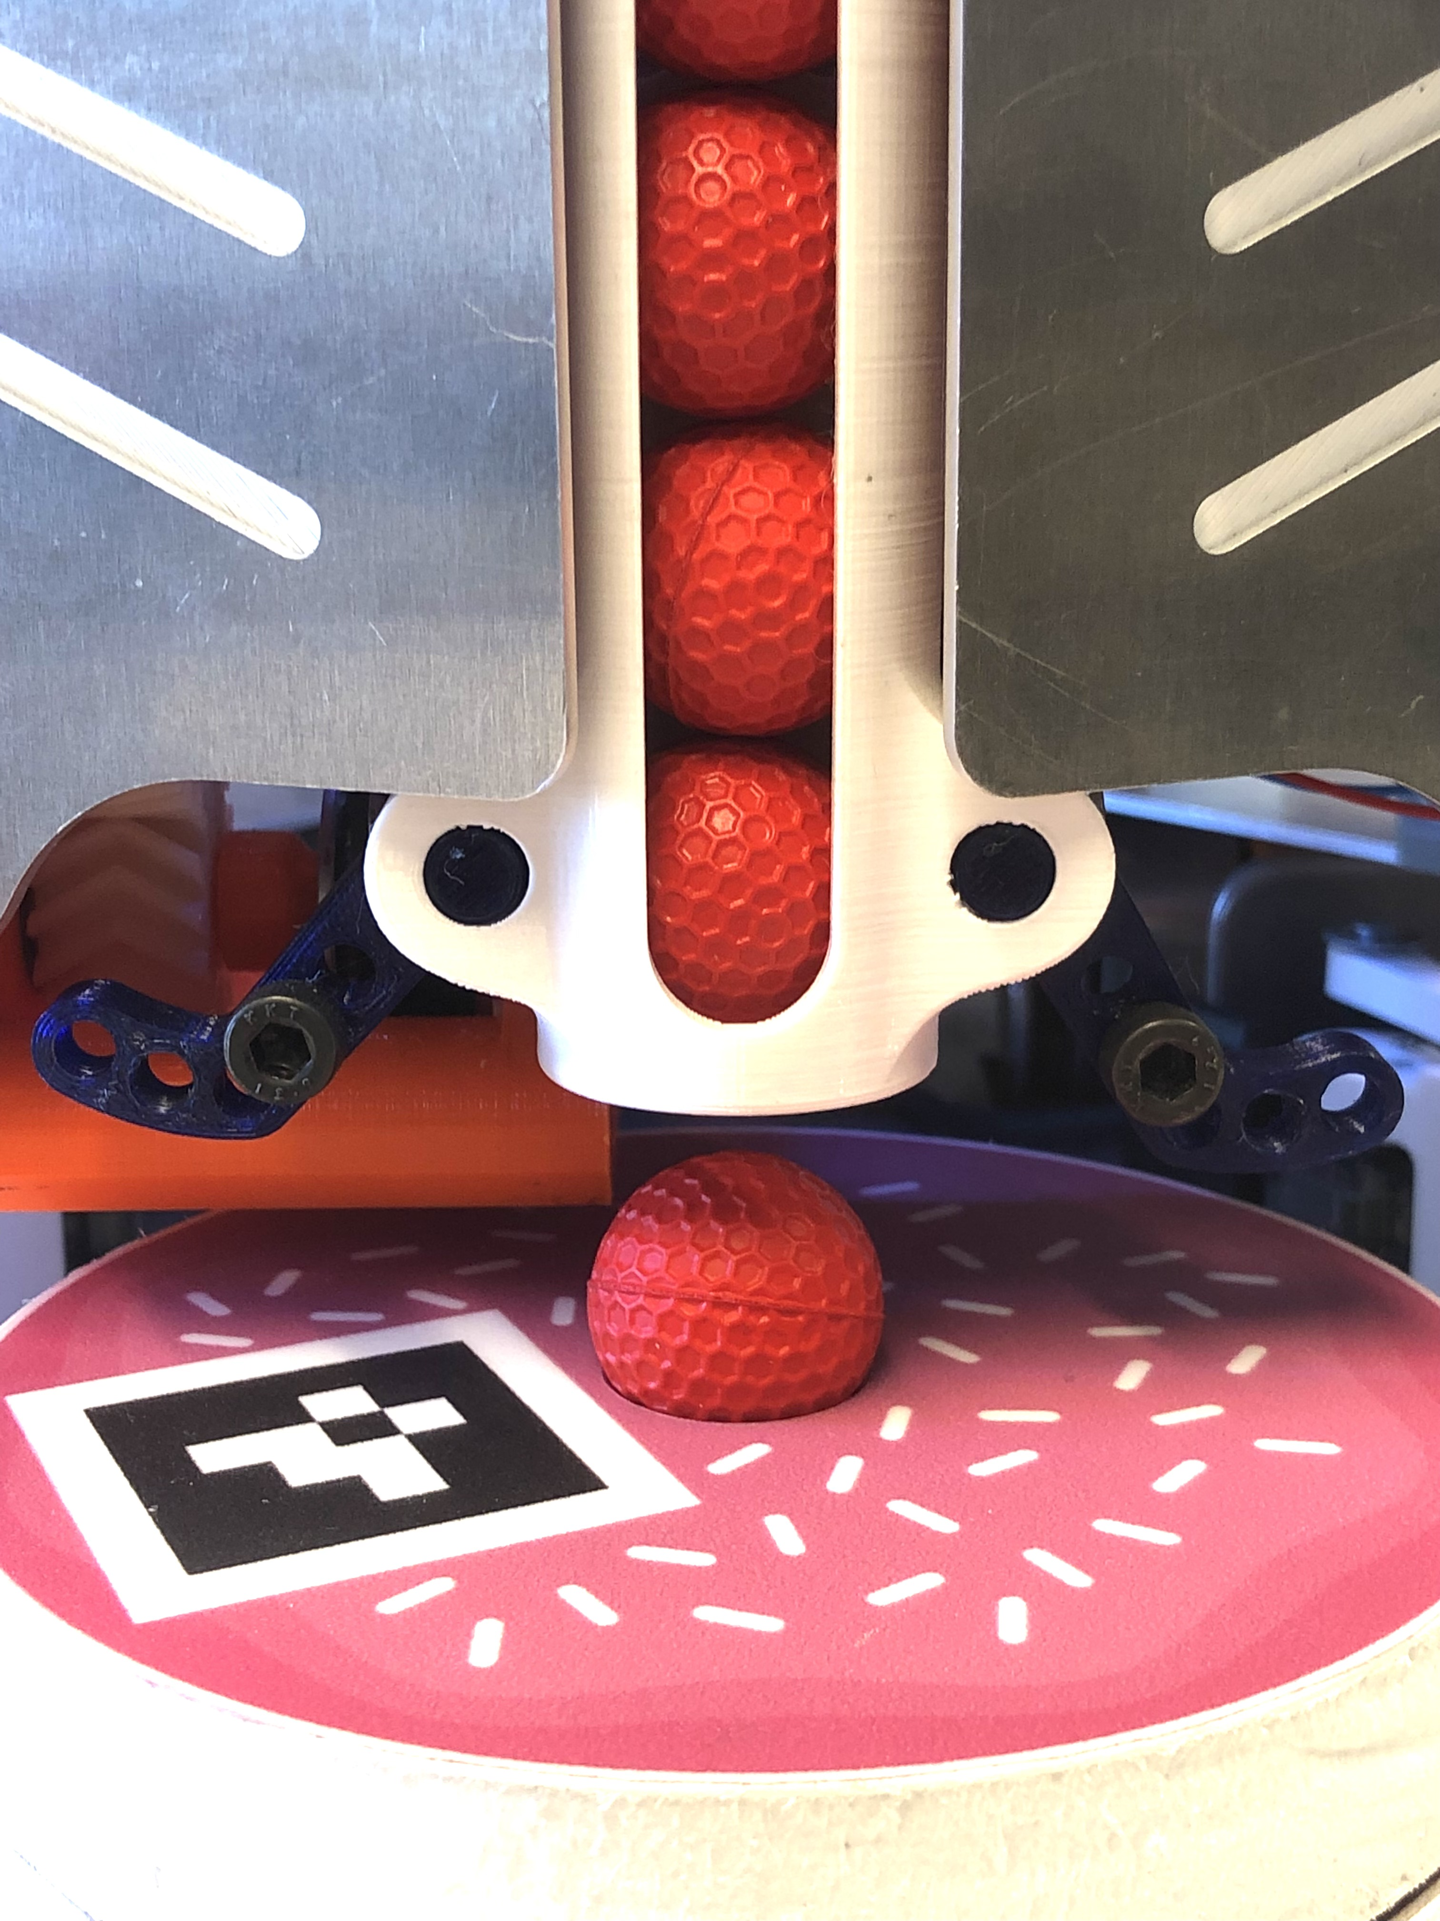
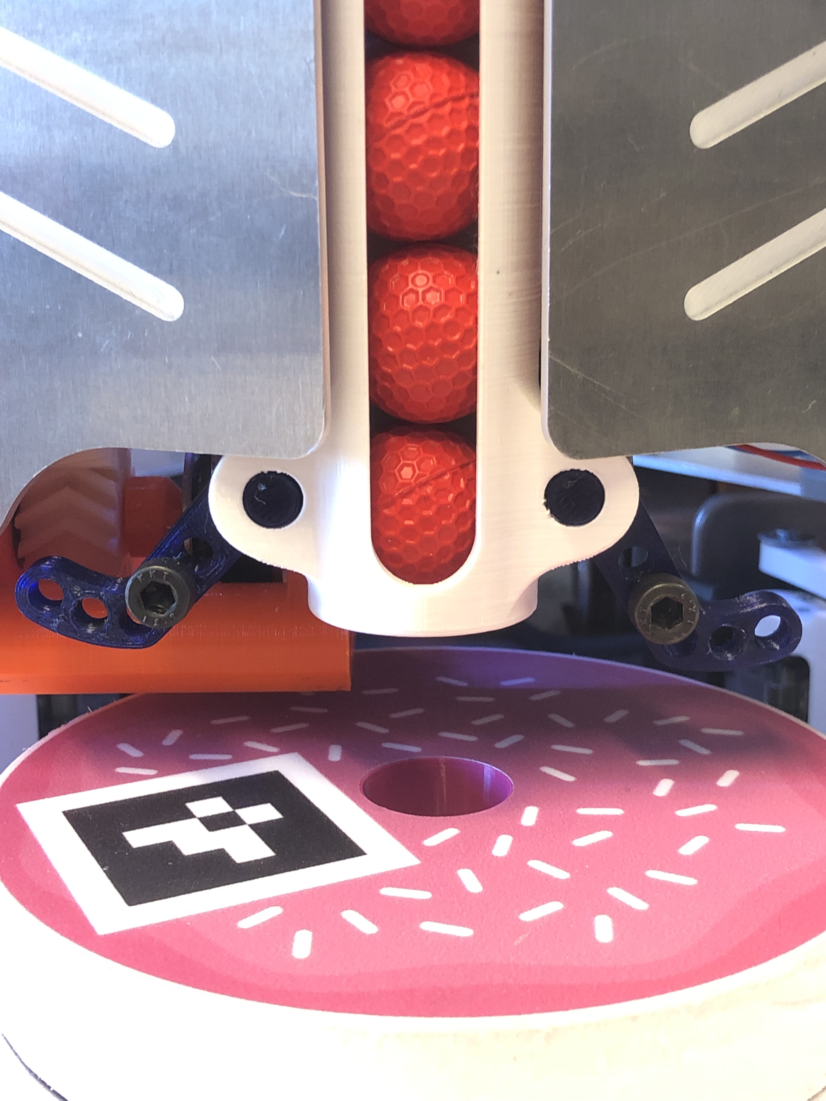

Slide 5
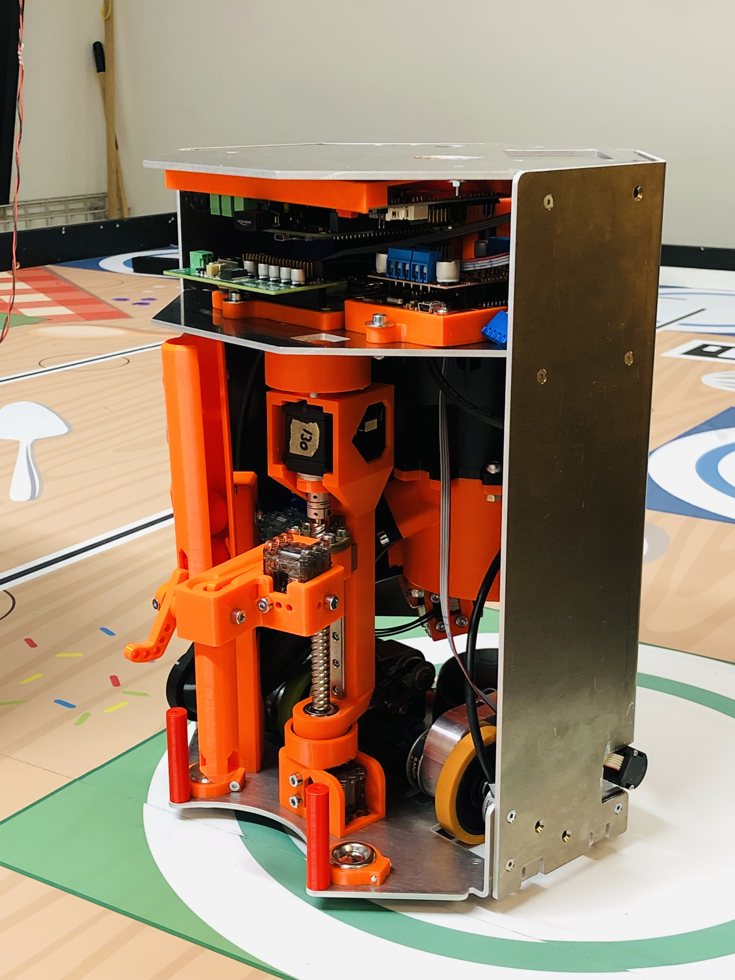
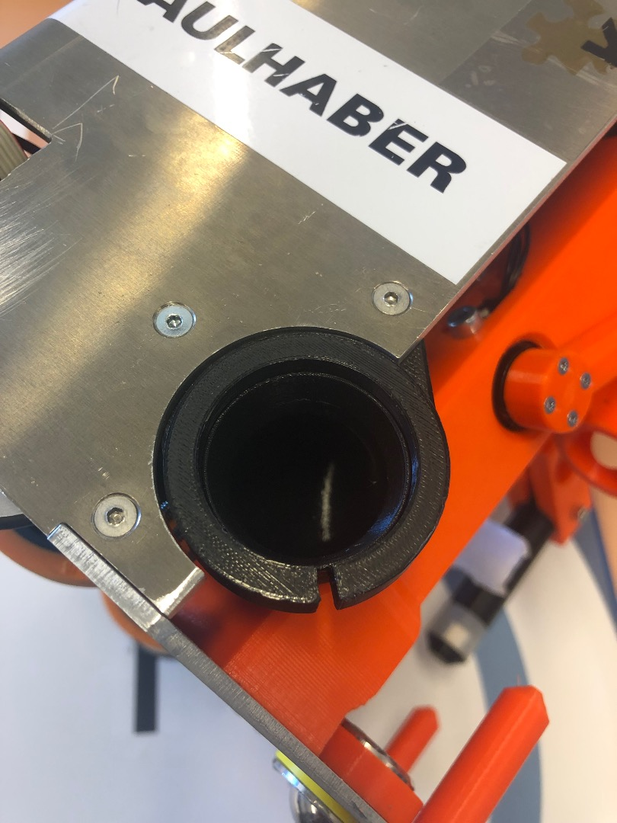
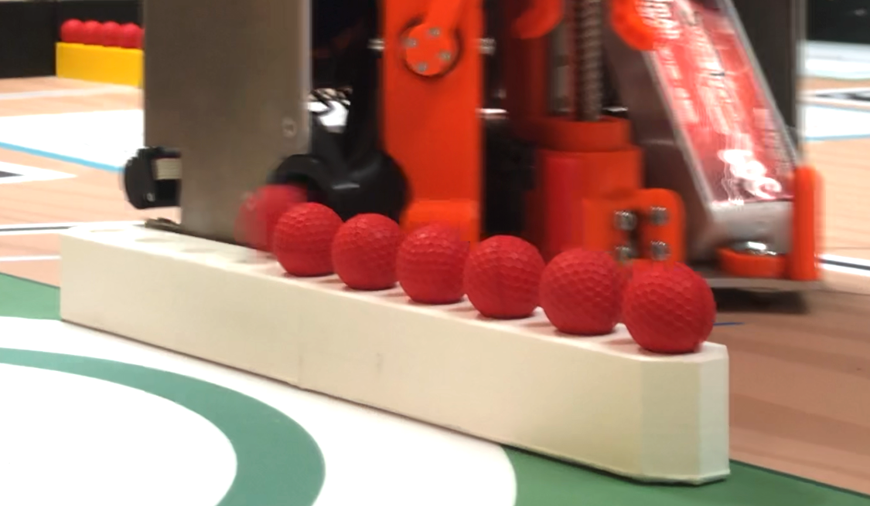
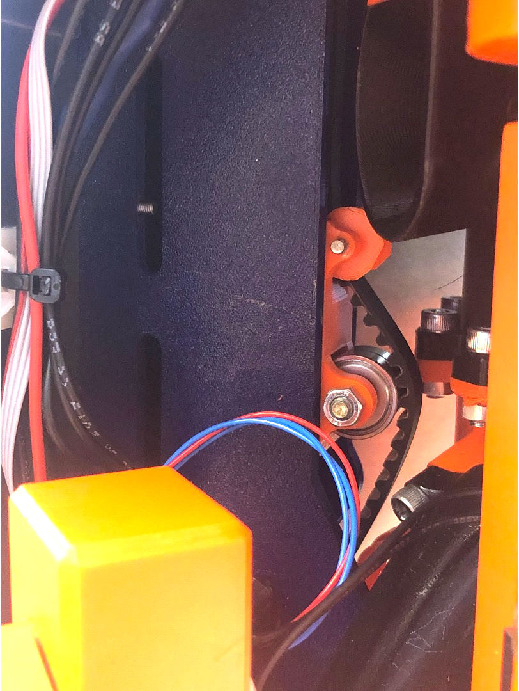
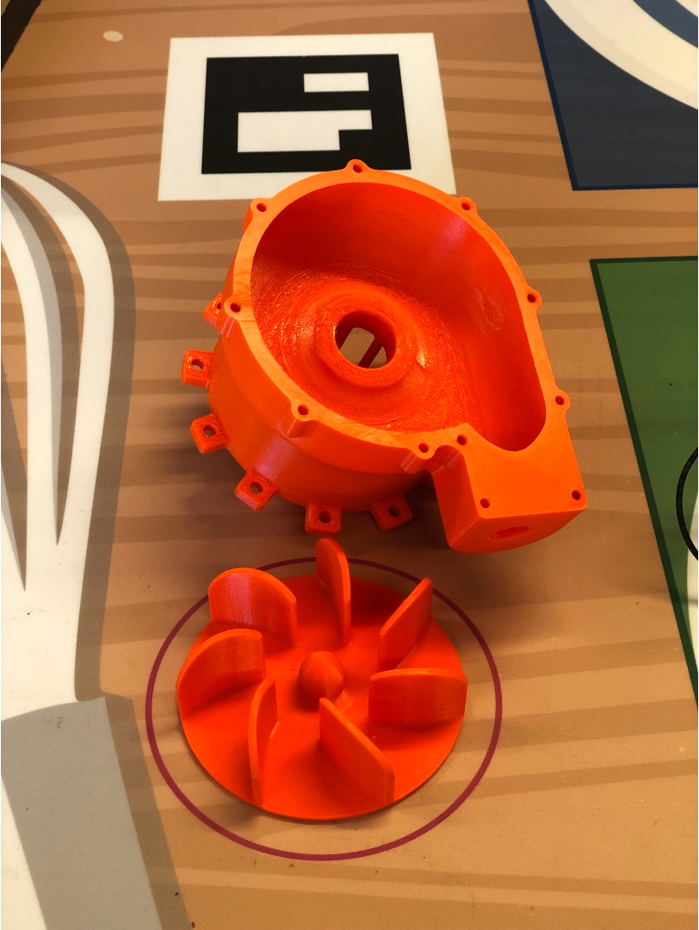

Slide 6
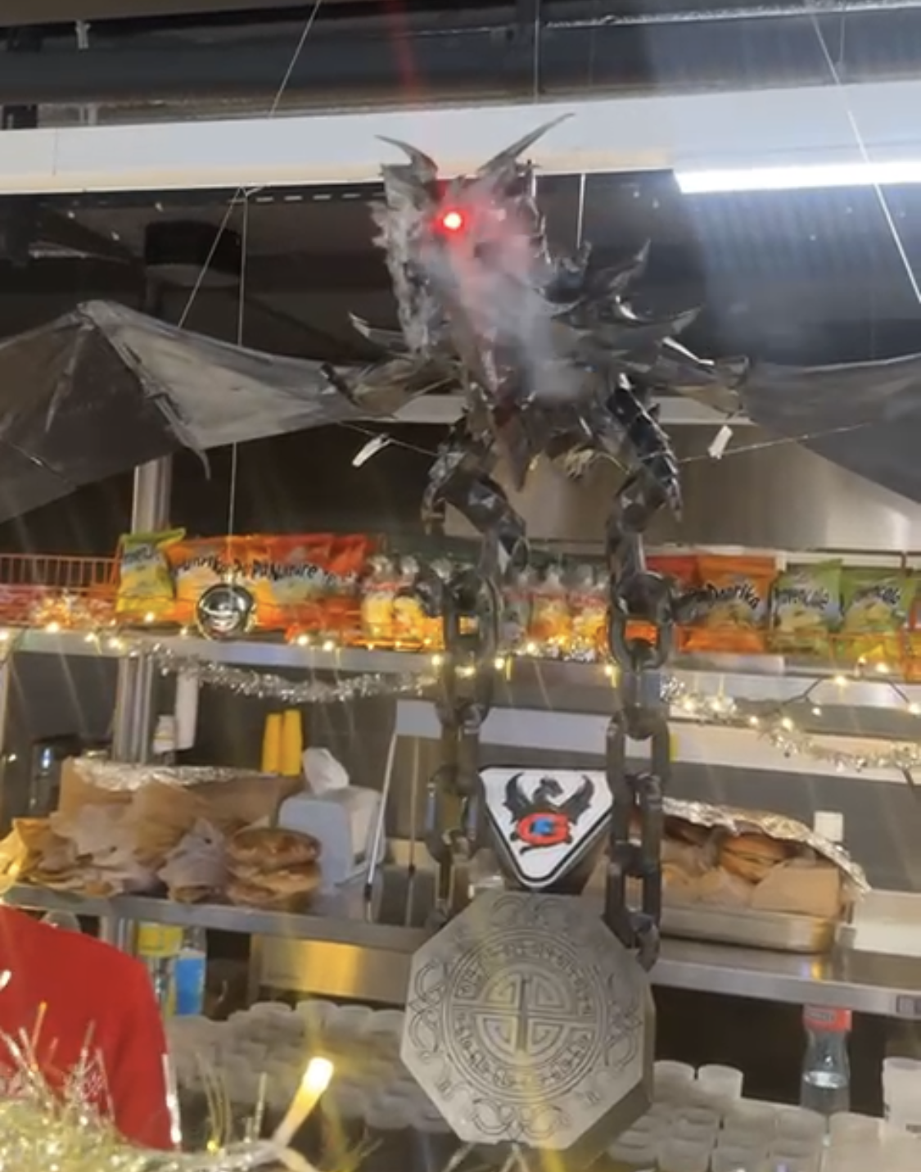
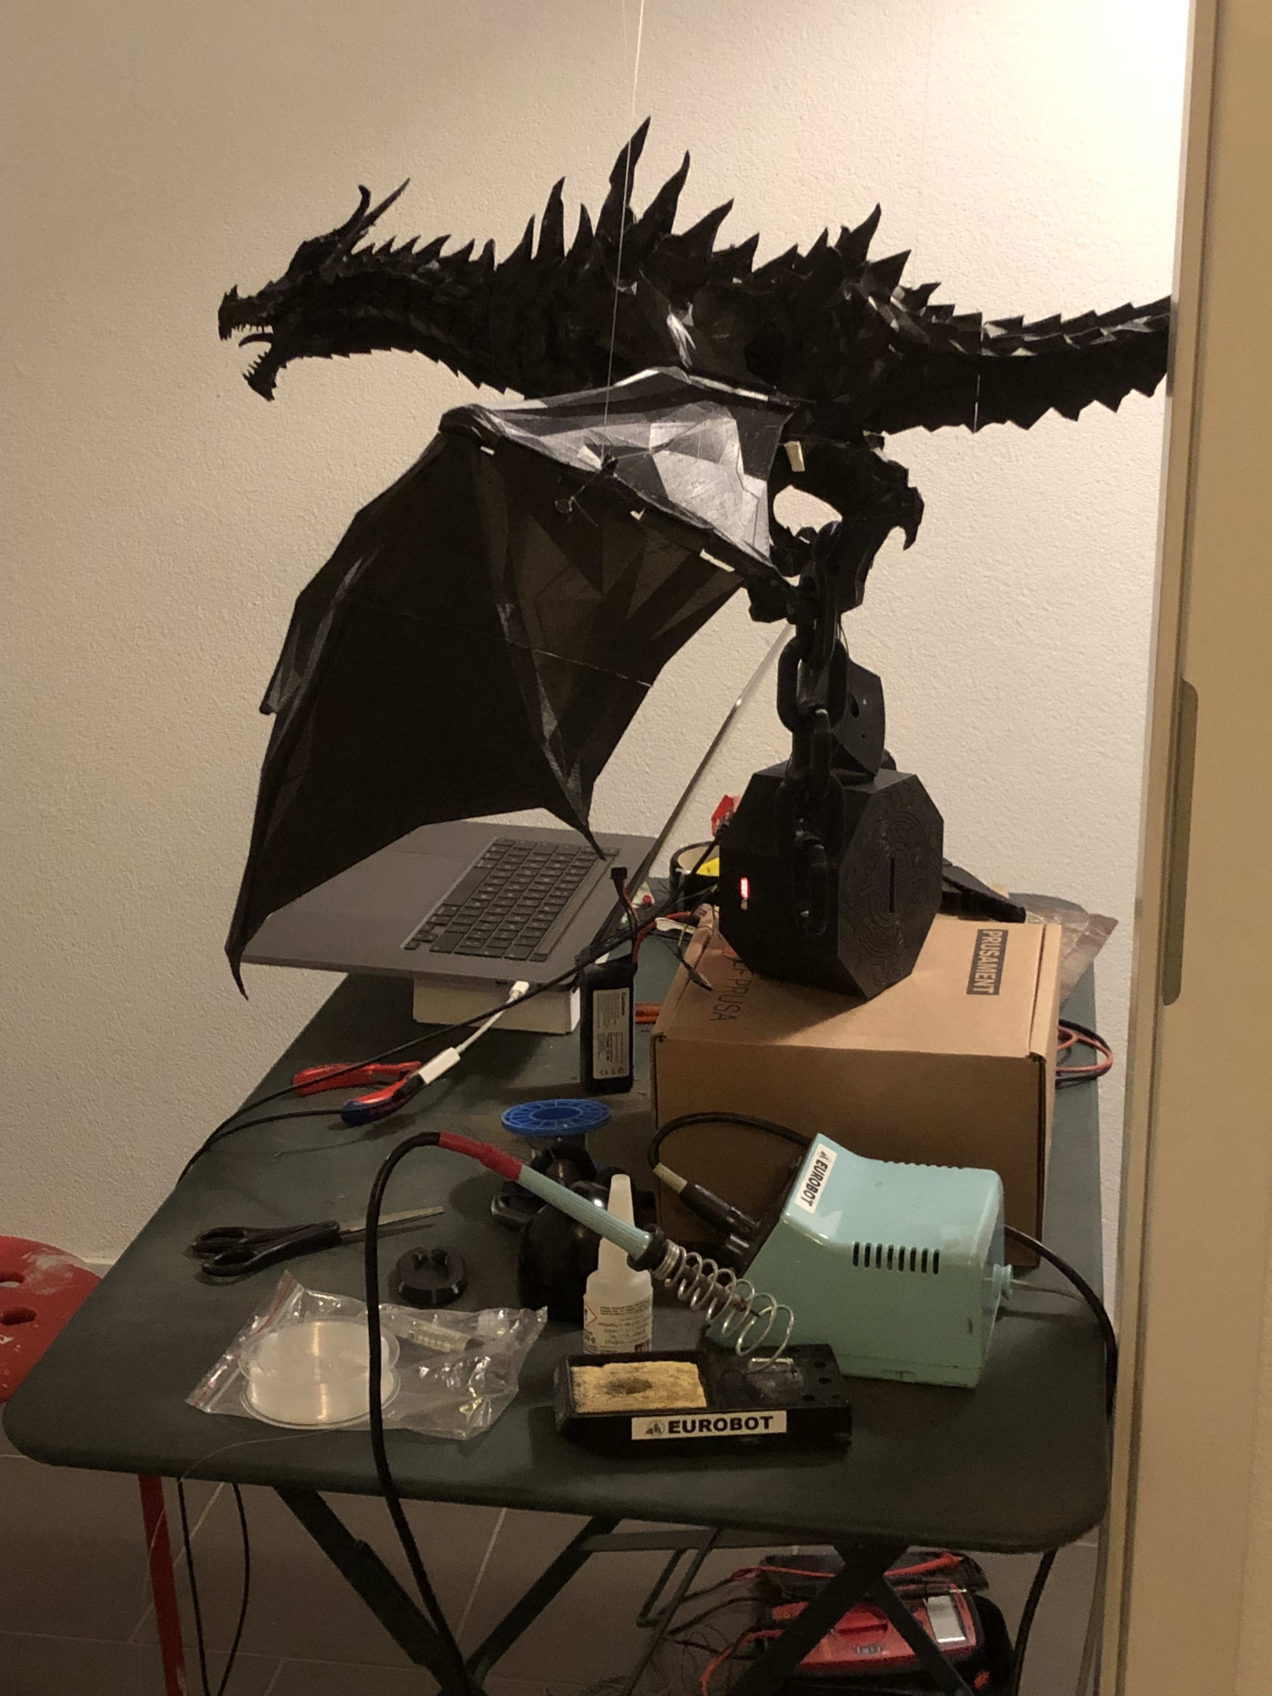
Dragon Themed Piggy Bank for Fribourg Gotteron
2023
Skills developed :
Unsolicited solo project
Adapting a Free 3D Model
Design for 3D Printing
Electronic schematic & selecting components
Assembling / Wiring

Slide 7
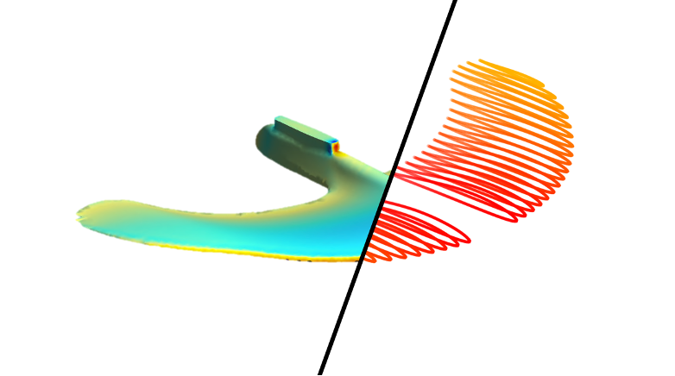
Simulating Drag and Lift of a Hydrofoil in Python
2023
Skills developed :
Programming in Python
Calling an External Program XFOIL from python
Solo project
Writing a technical report

Slide 8
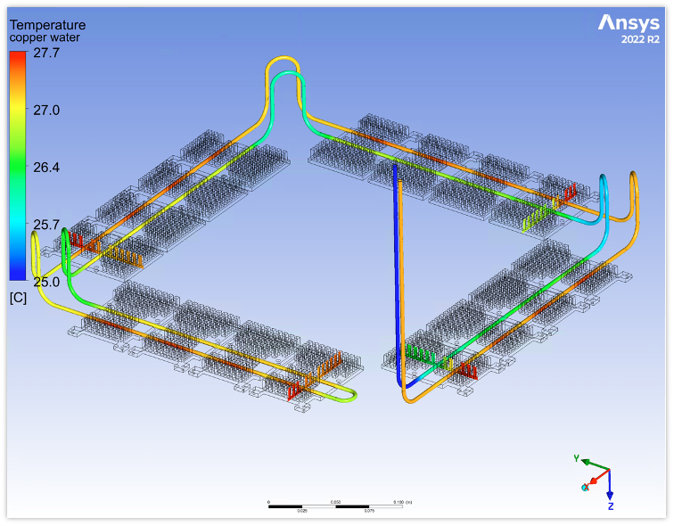

Water Cooling Setup for the CYGNUS 40L, a Neutrino and Dark Matter Detector
2024
Bachelor thesis : Alumni Award
Skills developed :
Thermal Simulations in Ansys Fluent 2023
Multitasking
Writing a Technical Report in English
Interdisciplinary teamwork

Slide 9
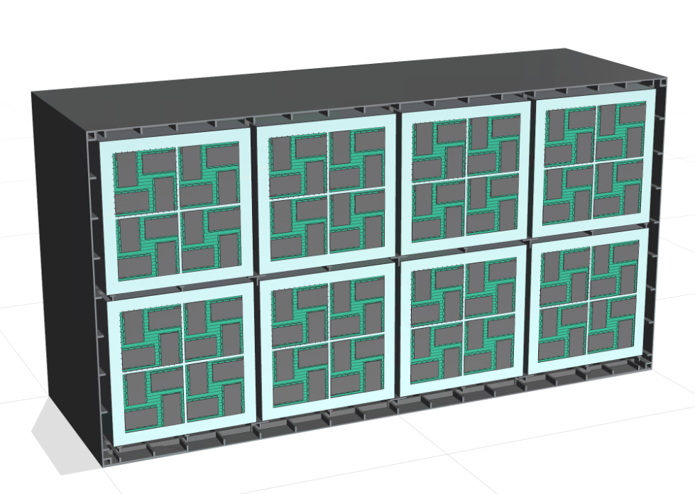
Design Proposal for a Future 12m³ Neutrinos and Dark Matter Detector
Skills developed :
CAD Design with Siemens NX
FEM Simulation with Nastran solver
Teamwork
2024

Slide 10
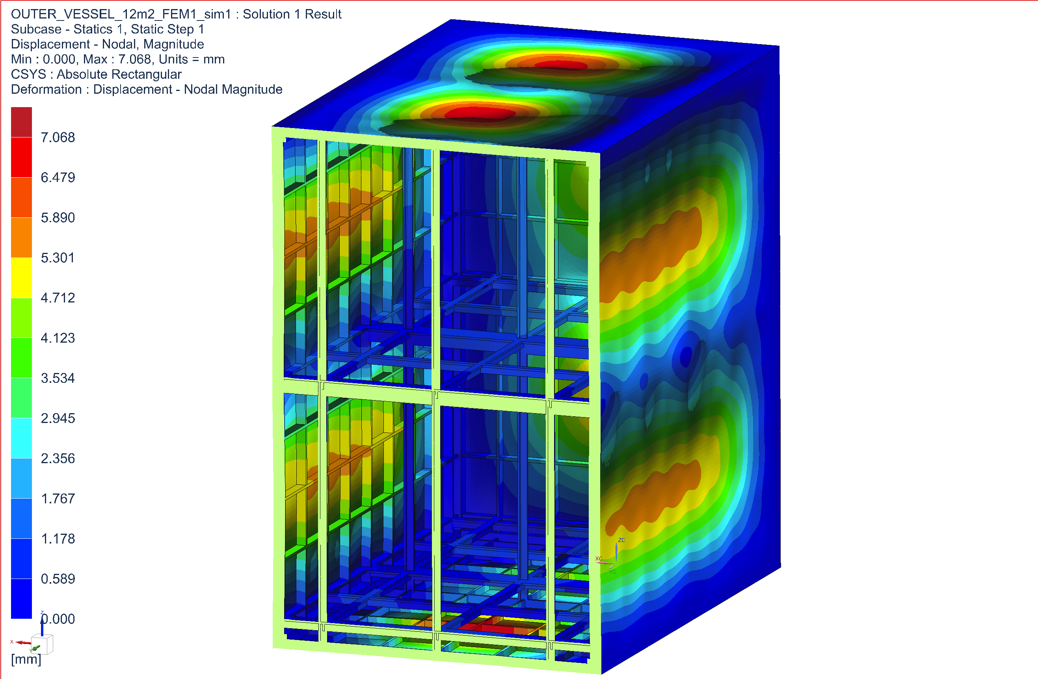
Design Proposal for a Future 12m³ Neutrinos and Dark Matter Detector
Skills developed :
CAD Design with Siemens NX
FEM Simulation with Nastran solver
Teamwork
2024

Slide 11
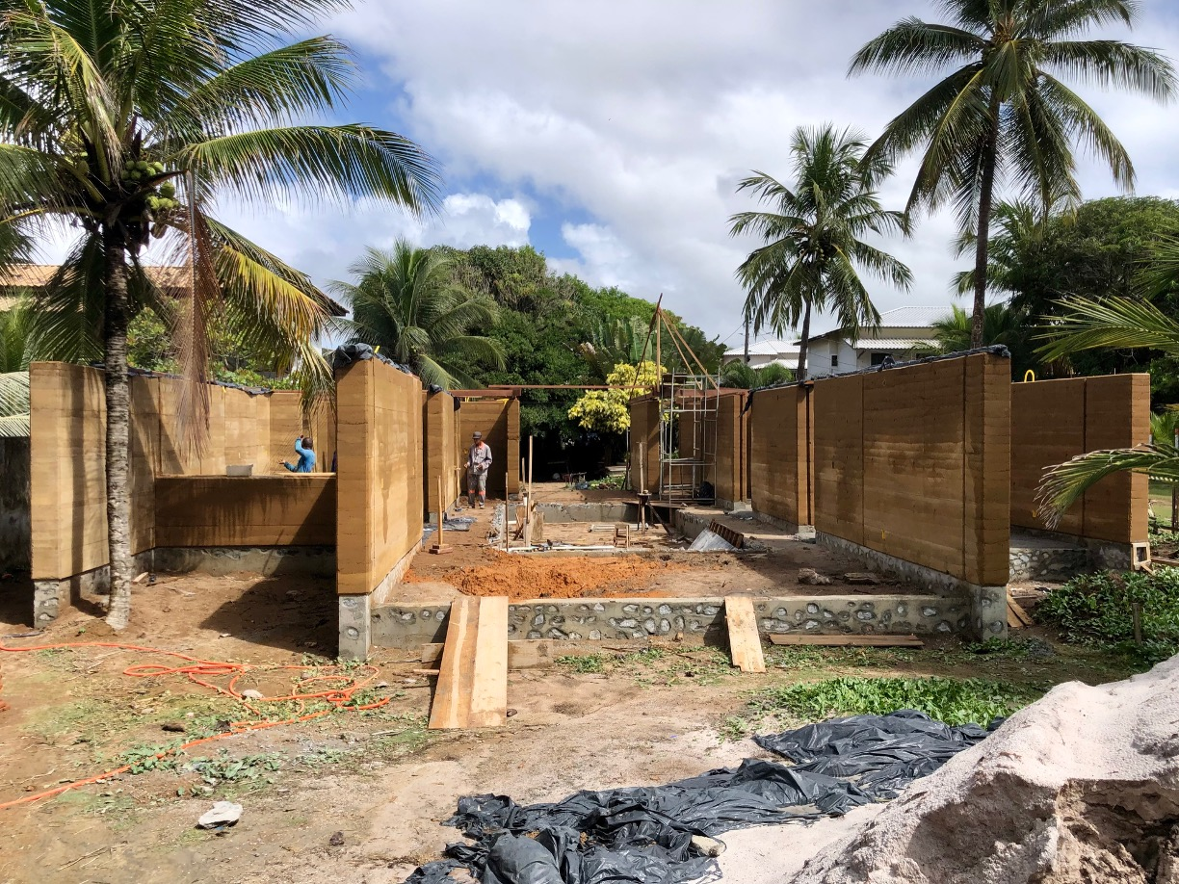
Family project, building a house
2024-2025
Skills developed :
Team management
Planning management
Outdoor manual work
Earthen wall construction

Slide 12
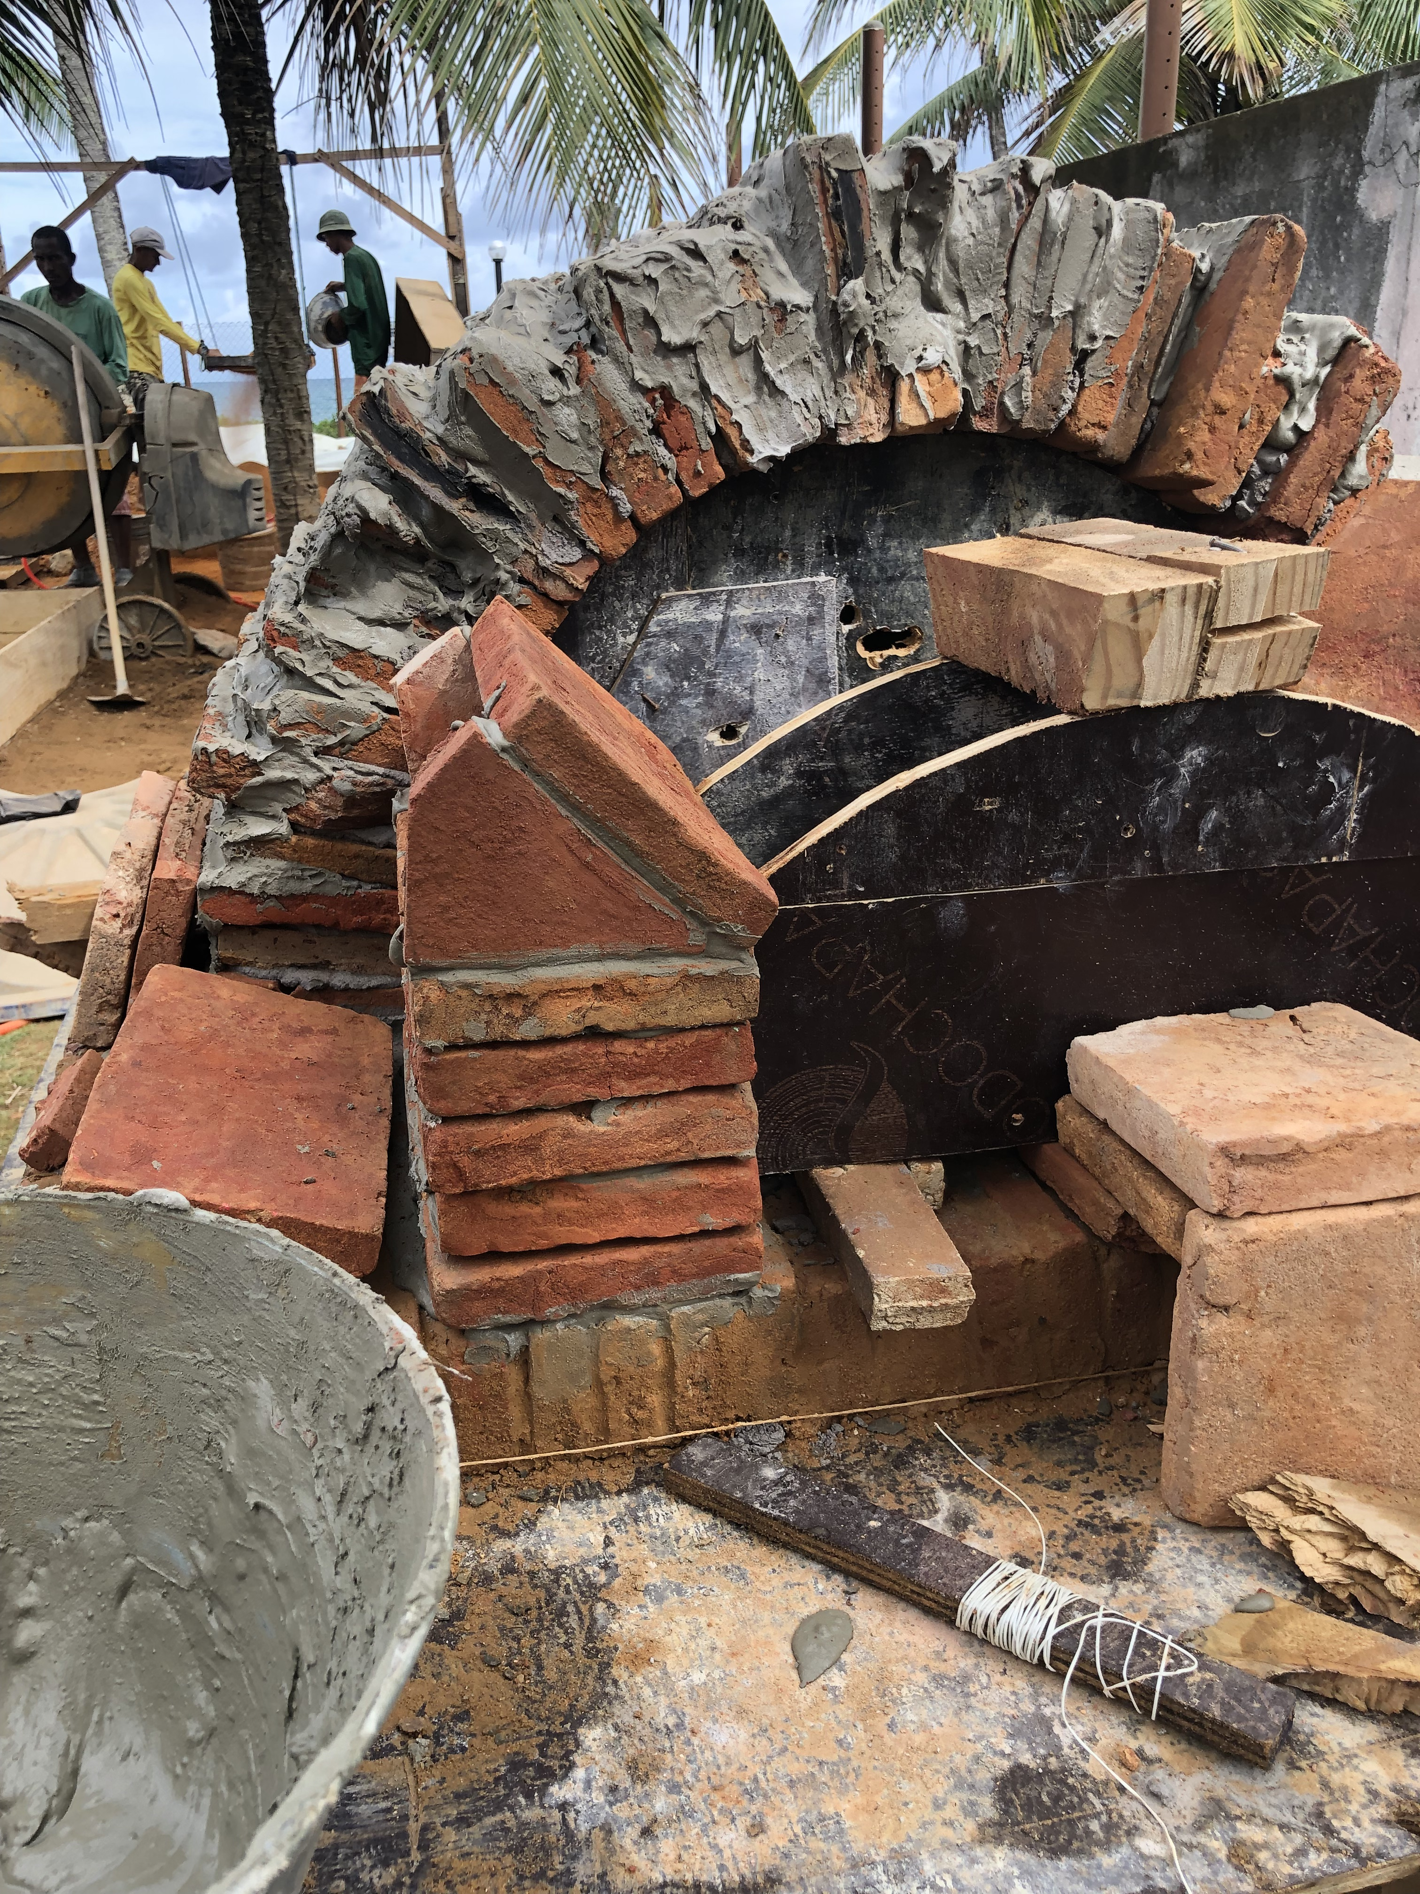
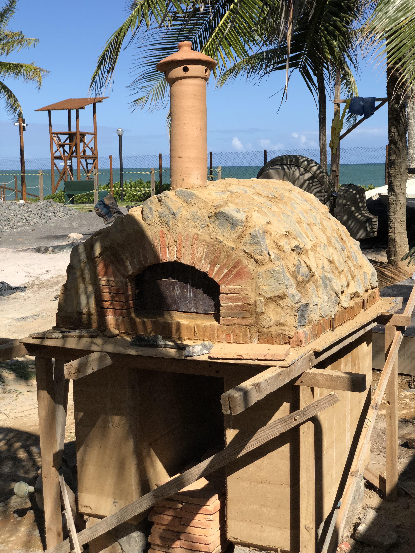
Pizza oven
2025
Skills developed :
Solo personal project
Material Planning / ordering
Learning from literature
Outdoor manual work

Slide 13
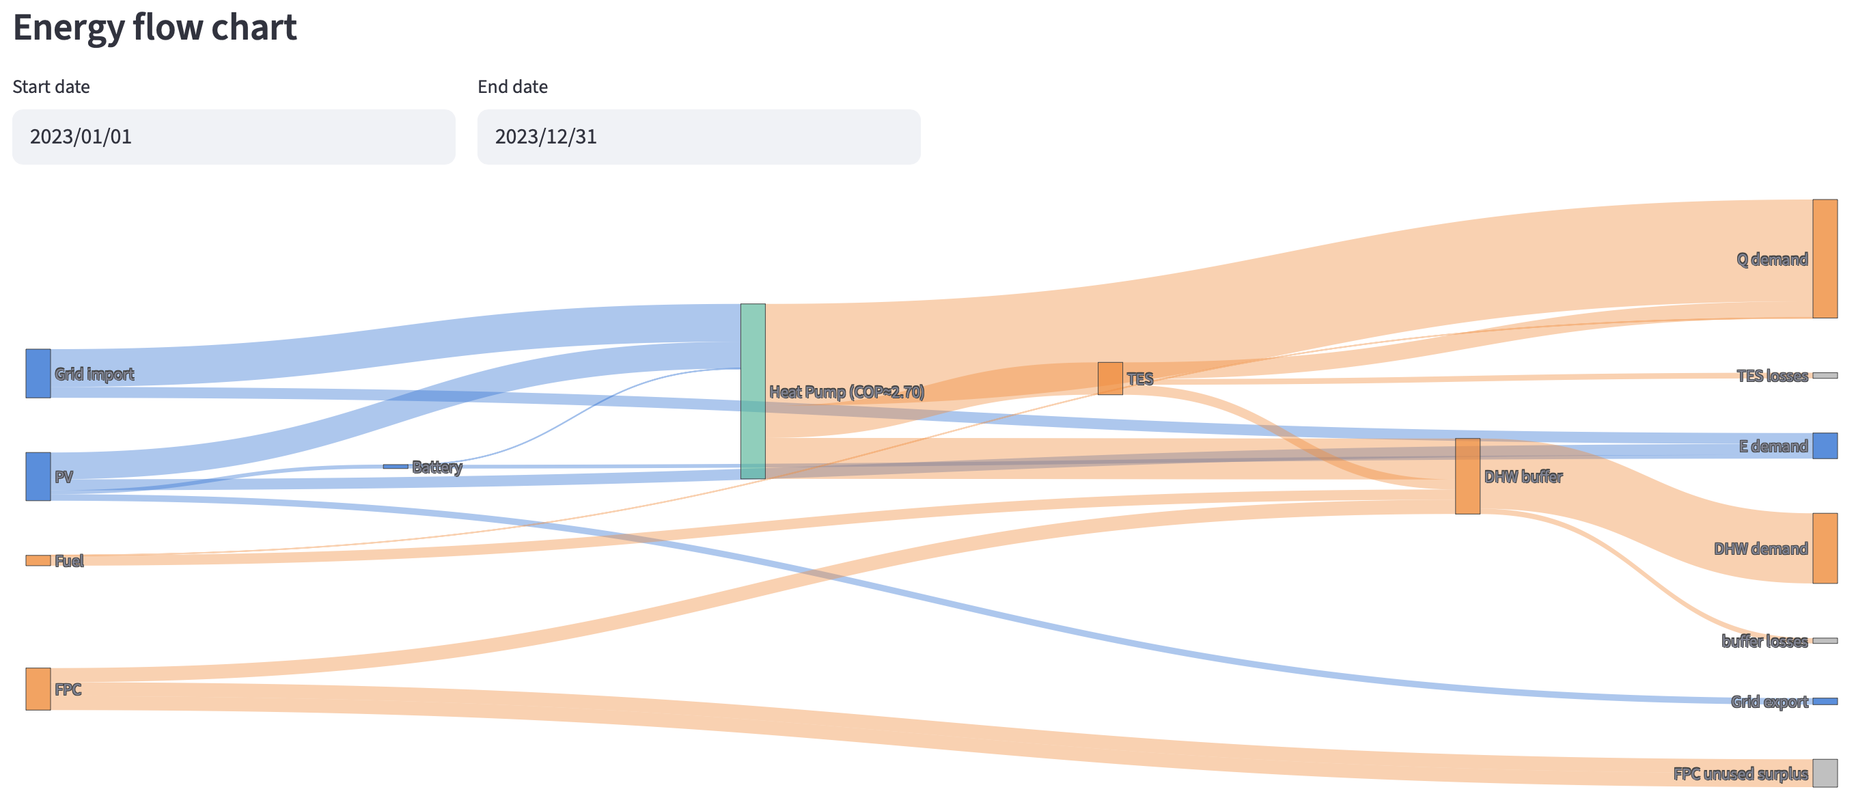
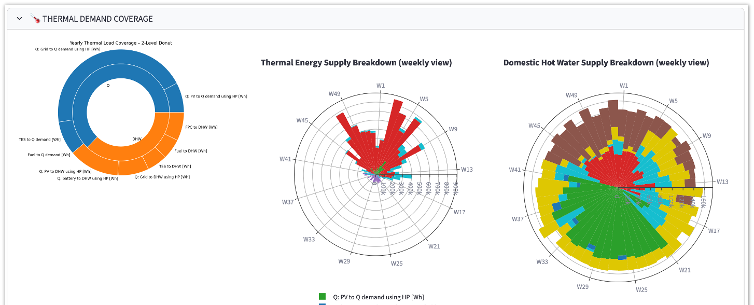
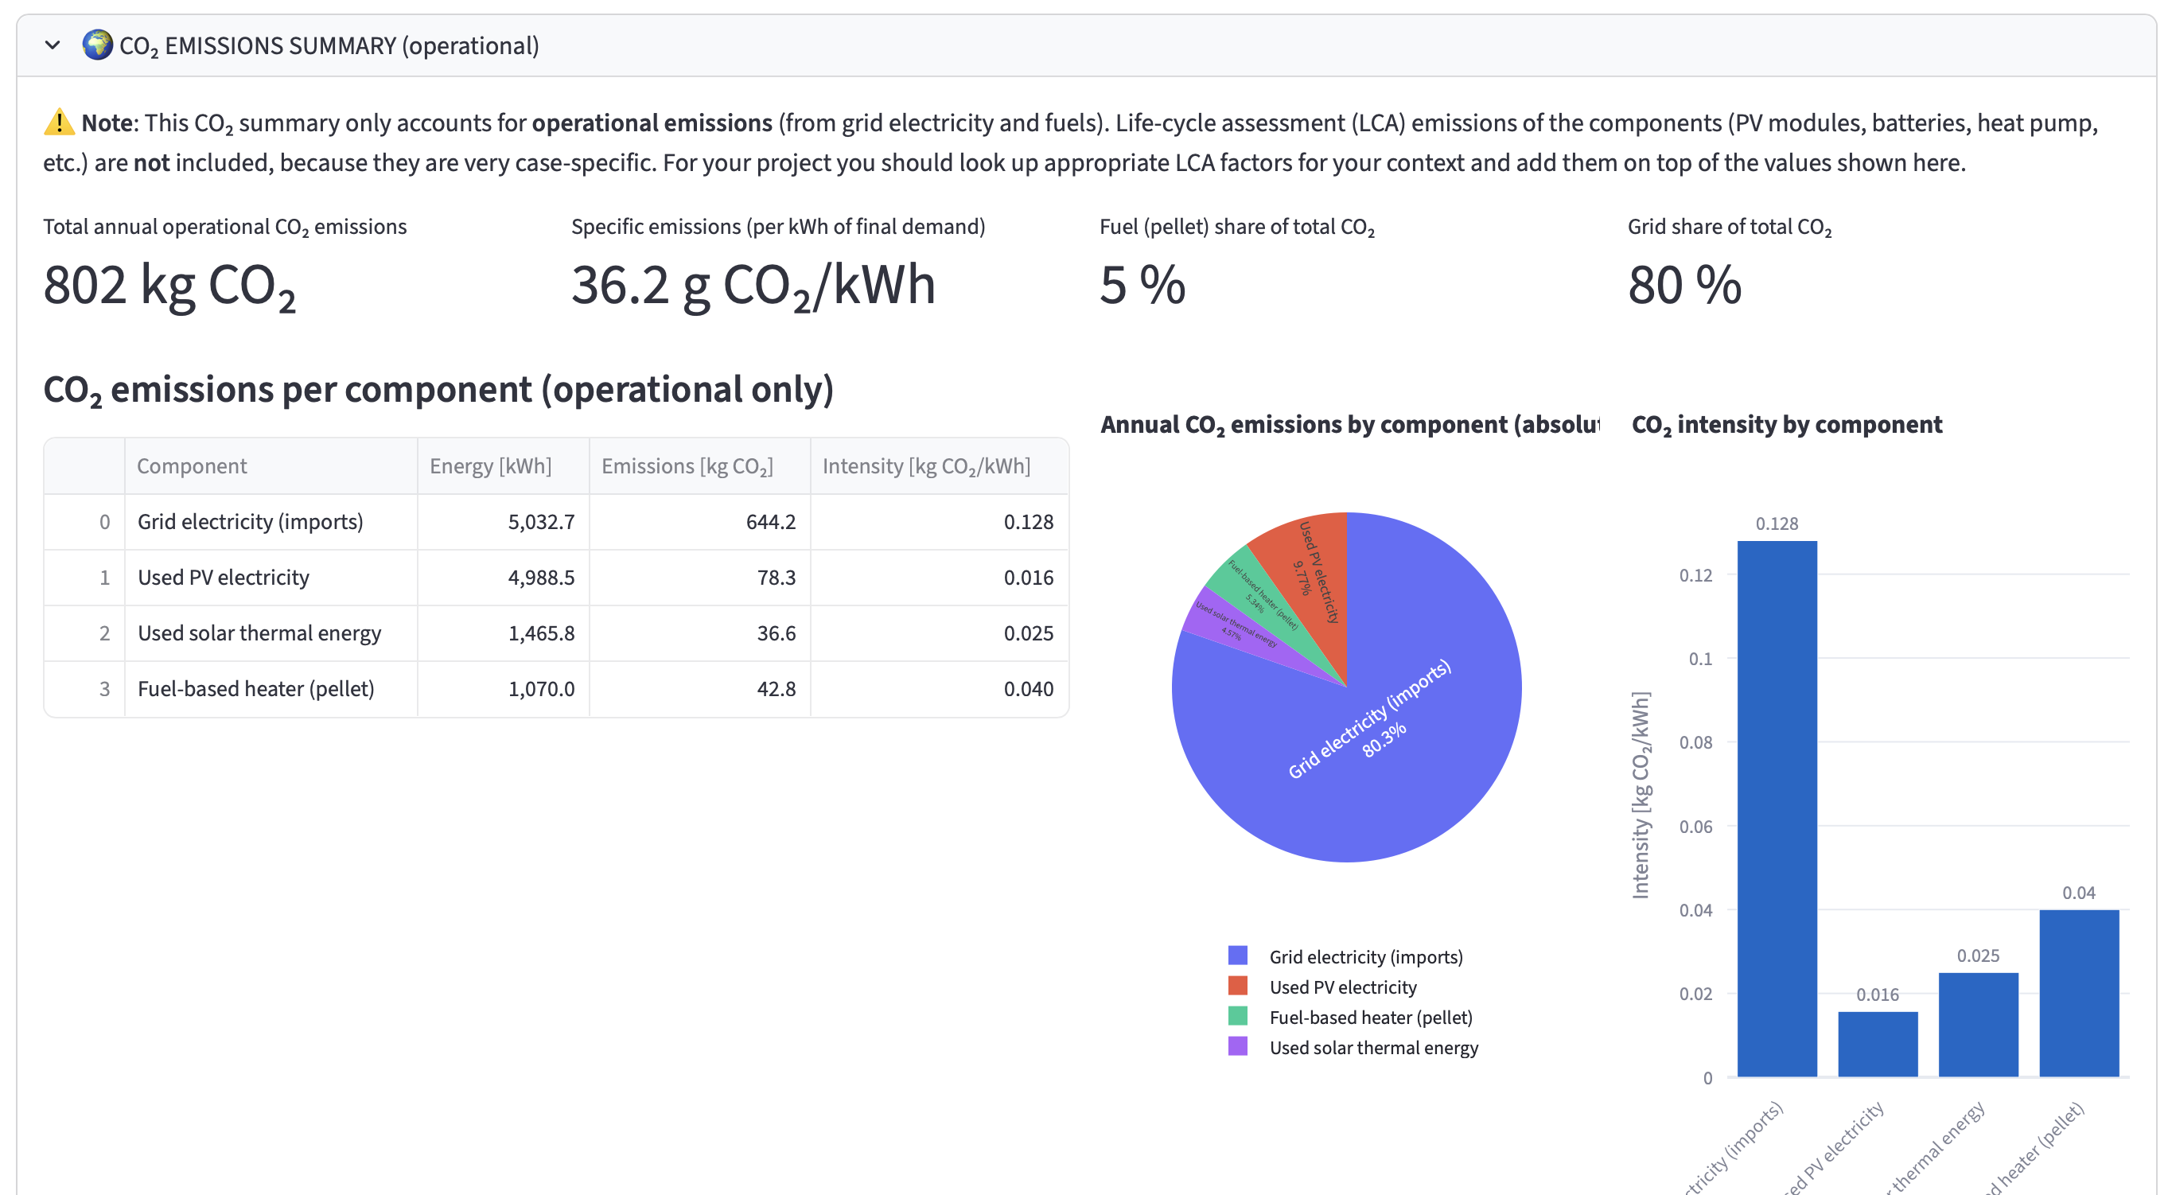

Energy simulation tool
2025
Skills developed :
Python
Web interface deployment
Working with existing documents
GitHub
https://energysim.recommendertool.ch

Slide 14
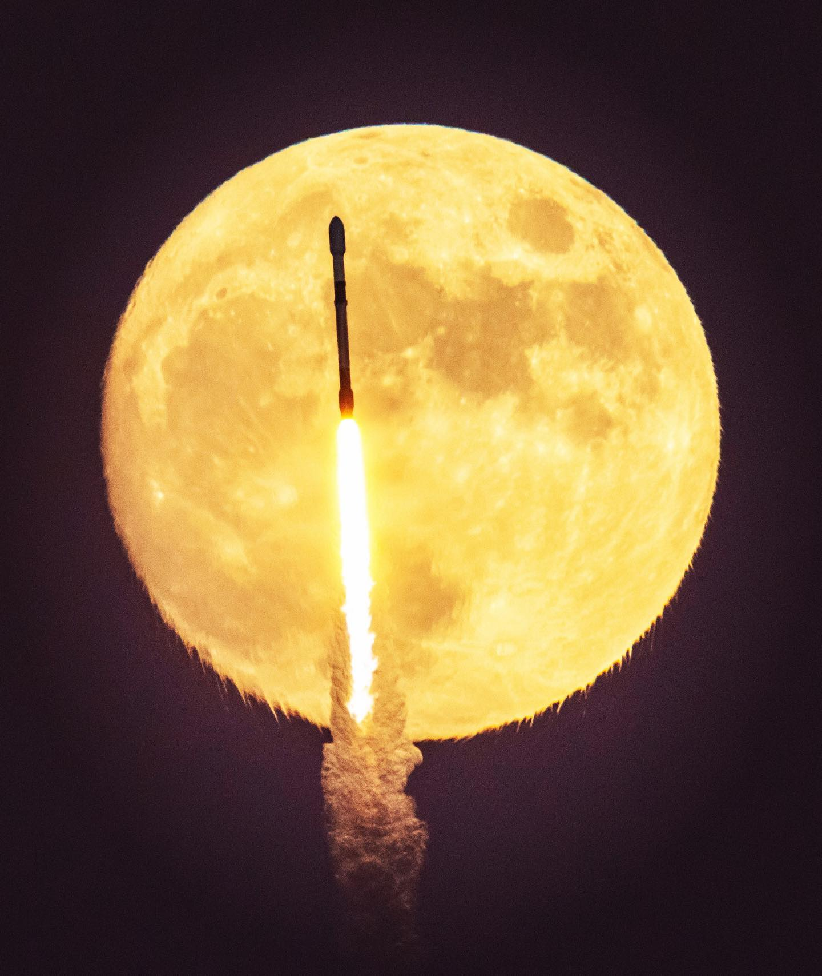
To be continued …
joe marino/imago

